Slide 1

3. JDK Service Loader
CBSE – Mundtlig Eksamen
pahan19@student.sdu.dk
Patrick Hansen

Slide 2
Hvad er et komponent?
Komponent
Karakteristika
Fordele
Brug
Interfaces
Glue kode
Notes:
Karakteristika
Et komponent baseret system kan samles og skilles ad.
Et sæt af relevant komponenter giver os et fuldt system
Komponent baseret system udvikles typisk som en samling af mindre dele
Fordele
Løse problemer vha. Separation of Concerns
Opdele ansvars områder
Genanvendelighed
Pick-and-choose
Maintainability (testing, udskiftning, videre udvikling, bug-fixing)
Normalt skal software integreres, men kan vi ikke samle det i stedet? Composition
Lav kobling vs høj kobling
Modules that know too much about other modules make changes hard to coordinate and make modules brittle. If Module A knows too much about Module B, changes to the internals of Module B may break functionality in Module A.
Brug
Interfaces giver os Dependency Inversion og Inversion of control.
Glue kode er en form for manuel assembly der kan ske automatisk med en component model
Interfaces
The use of interfaces eliminates the tight coupling between components during the build time.
If you import a component w/o the use of interfaces, you depend on the component you imported.
This means that the application component could not be developed in isolation from the
business component. This is an impediment to independent component fabrication.
To solve the build time dependency problem, we can make use of Java interface construct.

Slide 3
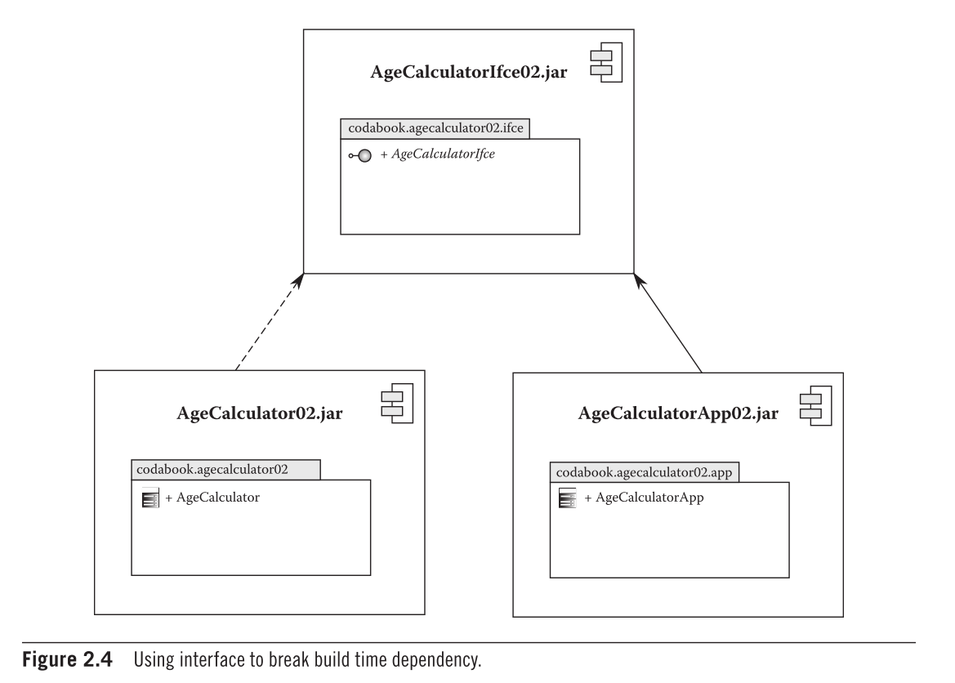
Java Komponenter
Logiske og fysiske grænser
Kan uafhængig komponent udvikling lade sig gøre?
Løsningen er Java interfaces (og pakkes i en selvstændig .jar)
Dermed har vi løst build time dependencies til implementationer…
Notes:
Logiske og fysiske grænser
- Pakker er logiske, jar filer er fysiske
Uafhængig komponent udvikling lade sig gøre?
Uafhængige modul implementation betyder at vi ikke kan have dependencies
Vores app må jo have build time dependencies, og kan dermed ikke udvikles isoleret fra resten af systemet
Resultat: Udviklingen af nogle komponenter udsættes
Løsningen er Java interfaces (og pakkes i en selvstændig .jar)
Og vores app requirer den…

Slide 4
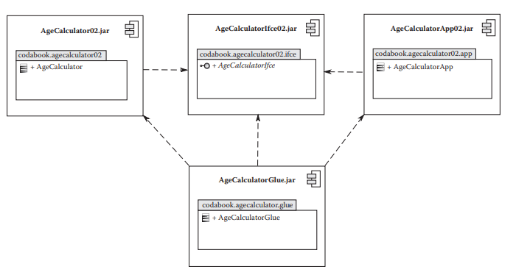
Glue code
Notes:
Vi vil hellere automatisere. Træls arbejde at instantiere og injecte alt

Slide 5
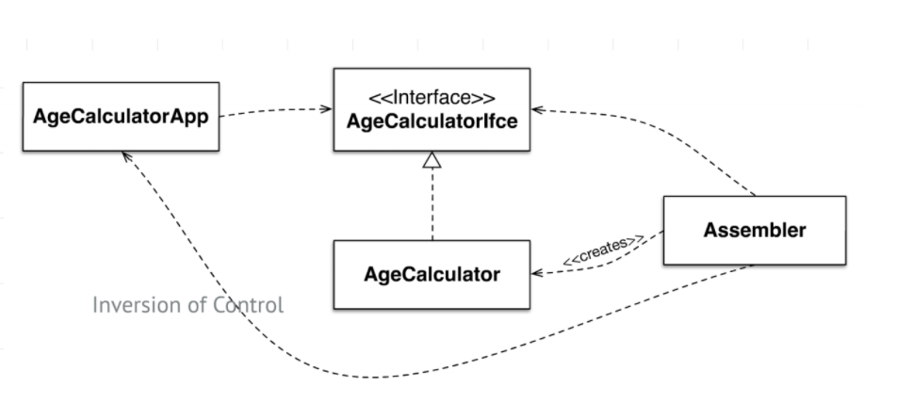
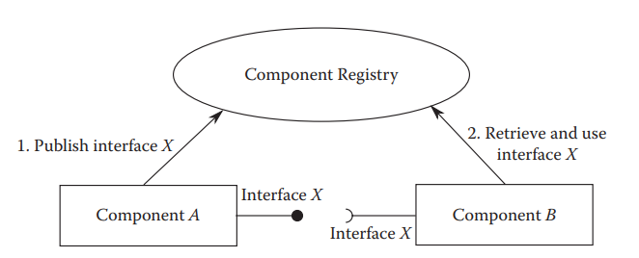
Komponent modeller
Dependency Inversion
Dependency Injection baserede modeller
Whiteboard
Registrering
Forespørgsel
Et par komponent frameworks
OSGi
Spring
NetBeans
Inversion of Control
Notes:
En component model er en standard der standardiserer mekanismerne til require/provide og kan automatisere assembly
## What are the different types of component models?
A component model is a definition of properties that components must satisfy, methods and mechanisms for the composition of components
### Dependency injection-based component models
Inversion of Control
Separate what-to-do part from when-to-do part.
Ensure that when part knows as little as possible about what part; and vice versa.
Dependency Inversion
Moduler afhænger af abstraktioner (interfaces)
Each component declares the set of interfaces provided by it and the set of interfaces required by it.
- The component framework analyzes this information on all the deployed components and injects the providing component references to requiring components
### Publish and consume whiteboard query-based component models
Each component registers the set of provided interfaces with a whiteboard registry.
- Any component requiring an interface queries the whiteboard registry to obtain a reference to the providing component.

Slide 6
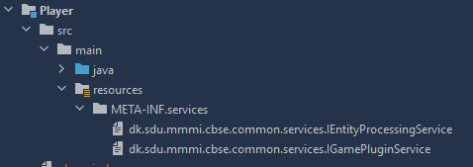
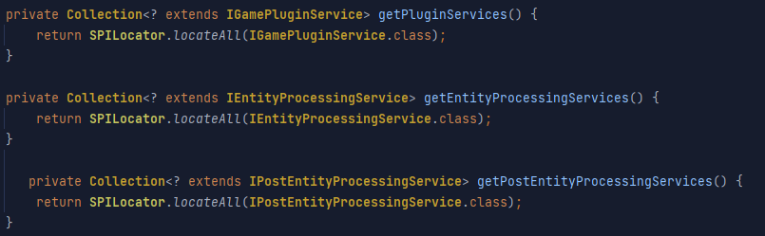
Portefølje eksempel
Notes:
Whiteboard eksempel
SPILocator kigger i komponenternes META-INF.services mappe og finder filer med interface navne og deres implementationer deri som en liste

Slide 7
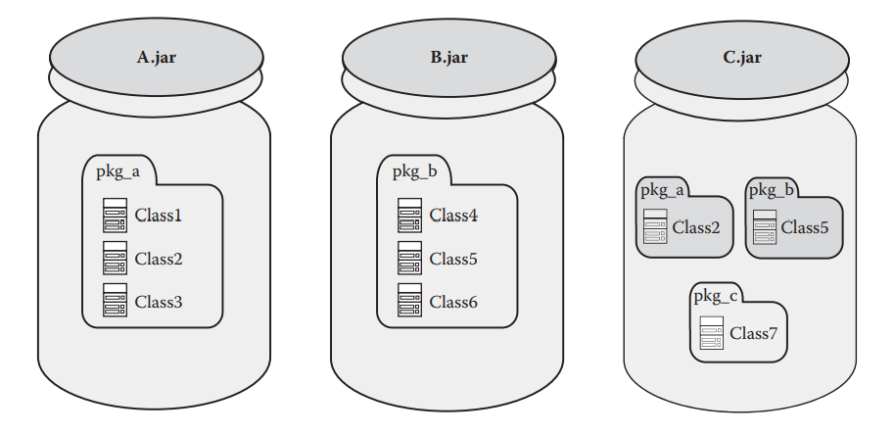
Problemet med Jar fil-baseret komponent model
Problemet med JAR fil-baseret komponent model
Flad classpath (præcedens!)
Komponent grænser ”opløses” ved runtime
Adfærd ændrer sig, runtime miljø bestemmer
OSGi’s Module layer er en løsning
Manifest
Notes:
## 1. What is wrong with the JAR file-based component model?
The physical and logical boundaries dissolve on a flat classpath. The packages and the implementations within have a precedence on the classpath. If package_a in Jar1 has Class2, and another package_b in Jar2 has Class 1, Class 2, and Class 3, and Jar1 is loaded before Jar 2, then Jar2 will be forced to use Jar1 -> package_a's Class2. This configuration happens at runtime and could cause unexpected behavior of the components.
> Root cause: The component boundary that keeps all related classes of the components together at development time is dissolving and dynamically changing at runtime
## 2. How does OSGi overcome the problems of flat CLASSPATH?
It wraps a _module layer_ around the JAR file. A module/bundle is the unit of deployment in OSGI.
It is:
- a regular JAR file that contains
- class files
- resource files
- metadata
- special because
- it carries additional metadata relevant to OSGi in the manifest of the JAR file
- `META-INF/MANIFEST.MF`
The OSGi framework provides **stronger boundaries** around the bundle by:
- having bundles explicitly export packages
- Classes that could usually lead to dissolving boundaries are loaded within the class loading context of a bundle, and are not visible outside the bundle (assuming they arent exported).
As a result, our boundary is consistent irrespective of CLASSPATH definitions in the environment.
> Finer control around physical and logical boundaries of a component using OSGi bundles,
> because a bundle needs to explicitly define what portion of its internal code is externally visible
A bundle must also explicitly declare any external dependencies that is has with the code exposed by other bundles.
The OSGi framework matches the exports and imports of deployed bundles to dynamically wire (compose) the entire application. This is called bundle resolution and ensures consistency among the different bundles in terms of versions and other constraints.
## 5. How is the unique identity of an OSGi bundle defined?
The symbolic name and version together uniquely identify a bundle
```
Bundle-SymbolicName: org.package.uniqueName
Bundle-Version: x.y.z.qualifier
```

